Slide 1

Linguistic levels of structure
Sound
Phoneme
ð iː z b juː t ə f ʊ l w ɪ m ɪ n s ɛ d w iː w ɜː t r uː m ɛ n
Morpheme
These beauti-ful women said we were true men
Word
These beautiful women said we were true men
Phrase
These beautiful women said: “We were true men.”
Clause
C(These beautiful women said: “C(We were true men.)”)
Sentence
These beautiful women said: “We were true men.”
Meaning
?

Slide 2
Types of phrase
Auxiliary + Lexical
- Have been playing
- Must know
Pre-mod + Head + Post-mod
- Her first attempt to fly a plane
- A charming small round old writing desk
Verb Phrase
Preposition + NP
In the dark
Through a lovely mountain
In contrast
Noun Phrase
Prepositional Phrase
Adverb Phrase
Adjective Phrase
Adverb + Head
- Amazingly well
- Extremely carefully
Adverb + Head + Post-mod
- Very anxious about Jim’s health
- Beautifully cool
Sentence
The little girl, confident in her ability, is playing amazingly well in the dark.

Slide 3
Verb phrase
Auxiliary + Lexical
- Have been playing
- Must know
Verb Phrase
Noun Phrase
Prepositional Phrase
Adverb Phrase
Adjective Phrase
Sentence
The little girl, confident in her ability, is playing amazingly well in the dark.

Slide 4




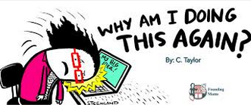

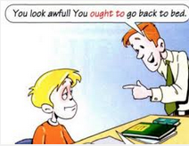

Review: Verb classes
Transitive (V + O) I love you.
Intransitive (V without O) I sleep.
MORE
Lexical love, sleep, run, know, …
(Refer to actions, events and processes)
Dynamic (be + -ing) I am running.
Static (Never -ing) I know.
Linking (Tell the state of being) She is cute.
Verb
Primary Be, have, do
Auxiliary
(Perform grammatical functions or express speaker’s mood)
MORE
Modal Will/would, shall/should, may/might, can/could, must, ought to

Slide 5
Review: Verb forms - Lexical
Infinitive (Dictionary) | 3rd person singular present tense | Other person present tense | Present participle | Past tense | Past participle
V | V-s/es | V | V-ing | V-ed | V-ed
(To) test | Tests | Test | Testing | Tested | Tested
(To) play | Plays | Play | Playing | Played | Played
(To) save | Saves | Save | Saving | Saved | Saved
(To) tie | Ties | Tie | Tying | Tied | Tied
(To) fly | Flies | Fly | Flying | Flied | Flied
(To) watch | Watches | Watch | Watching | Watched | Watched
(To) input | Inputs | Input | Inputting | Inputted | Inputted
(To) build | Builds | Build | Building | Built | Built
(To) run | Runs | Run | Running | Ran | Run
(To) go | Goes | Go | Going | Went | Gone
- Verbs are irregular if they have irregular past tense and past participle forms. - Except for some irregular verbs, past tense and past participle forms are the same.

Slide 6
Review: Verb forms - Auxiliary
Infinitive (Dictionary) | 3rd person singular present tense | Other person present tense | Present participle | Past tense | Past participle
(To) be | Is | Am/Are | Being | Was/Were | Been
(To) have | Has | Have | Having | Had | Had
(To) do | Does | Do | Doing | Did | Done
Will | Will | Will |  | Would
Shall | Shall | Shall |  | Should
Can | Can | Can |  | Could
May | May | May |  | Might
Must | Must | Must |  | Must
Ought to | Ought to | Ought to |  | Ought to
- All primary auxiliaries have irregular forms, except for present participle form. - All modal verbs only have 2 different forms for present and past tenses. They do not have infinitive or participle forms.

Slide 7
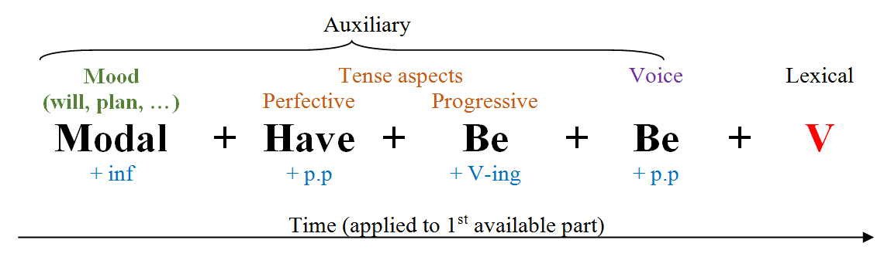
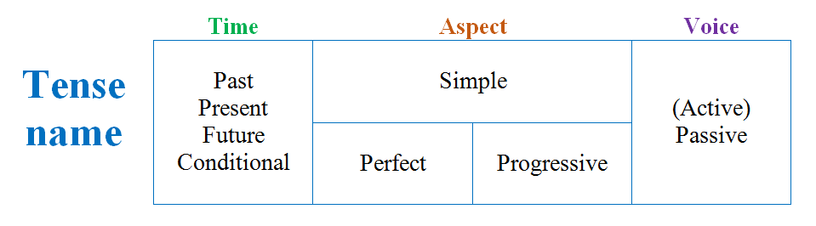
Verb phrase & Tense
Optional
Required

Slide 8
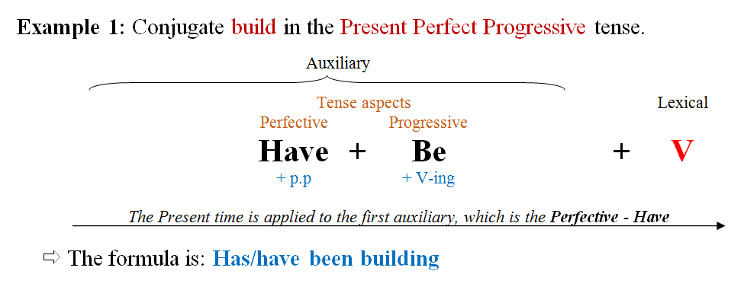
Verb phrase & Tense

Slide 9
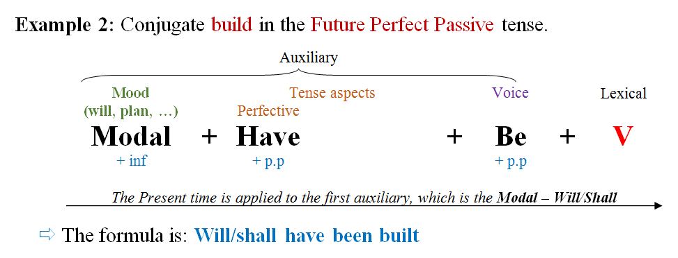
Verb phrase & Tense

Slide 10
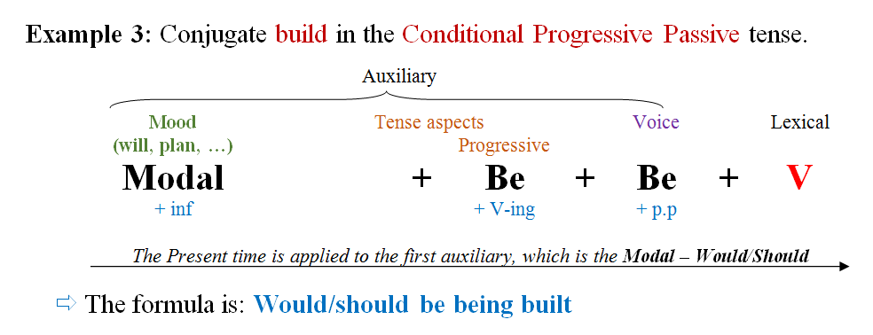
Verb phrase & Tense

Slide 11
Verb phrase - Operator
If there is no auxiliary, then DO will be the operator.
E.g. He walks away, doesn’t he? Does he walk? He didn’t walk.
If any, the operator is marked for tense. Otherwise, the lexical verb is.
E.g. He is coming. She walks.
1st auxiliary = OPERATOR
The operator is able to take contrastive stress.
E.g. He IS coming. She HAS been seen.
The operator changes places with the subject in most questions and inversions.
E.g. Is he coming. Does she walk?
The operator is repeated in a tag question.
E.g. He is coming, isn’t he?
Not is placed immediately after the operator. Not can be contracted and attached to the operator.
E.g. It will not be needed. He didn’t come.

Slide 12
Verb phrase – Final notes
Besides ‘do’, we also have ‘let’, ‘need’, ‘dare’
Let it go! Need I? Daren’t you say?
After an adverb of time (e.g. when, while, before, after, as soon as, etc.), we use a present tense instead of a future tense
I will have done it when you arrive here tomorrow.
Types of verb phrases
Finite: He has come from USA.
Non-finite: I want to go home, Going along the road, Kicked by a boy

Slide 13
Small test
What is wrong in these sentences?
He may have not eaten enough.
Like you drink some coffee?
You not work on it now.
He is not working, isn’t he?
It may have been not written yet, may it have?
When you will fly away tomorrow, I will have bought my ticket already.
Do you writing the paper again?

Slide 14

Any question?

